Slide 1

Mobile Technologies – Group Project
Diego Cossu
Max Noorland
Zain Abbas

Slide 2
Table of Contents
Idea
Technology
Main Screens
Business Model
Conclusion

Slide 3

Basic Idea
POLIMI Sports
Sports Booking app; used for booking courts and grounds
Aimed at student faculty primarily
Available on Android & IOS

Slide 4
Technologies
For app development, we can use React Native - which is JavaScript for Front-End and Back-End Management
For the UI/UX, design is created on Figma
For DataBase Management Systems – a relational database through the utilization of MySQL
For tracking the statistics of user demographic, behavior, usage of Google Analytics

Slide 5
Business Model
Aimed at POLIMI Students willing and able to play their desired sport
Every participant booking a court pays a service fee (€0.50) which is accounted for through a payment gateway
Partnerships and Collaborations with Sports Companies such as Adidas

Slide 6
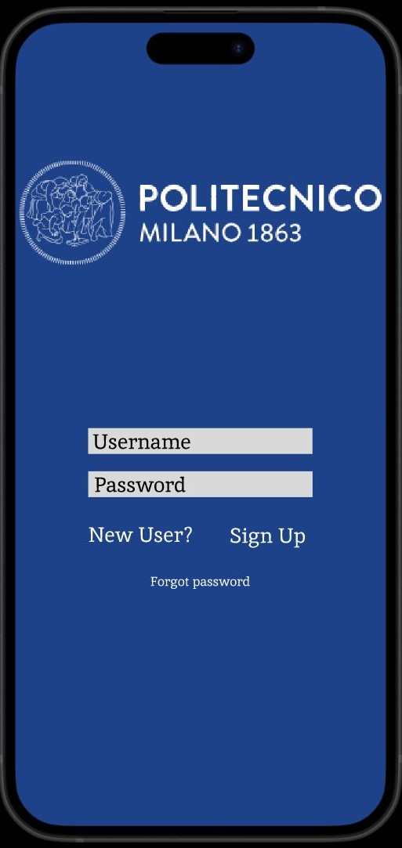
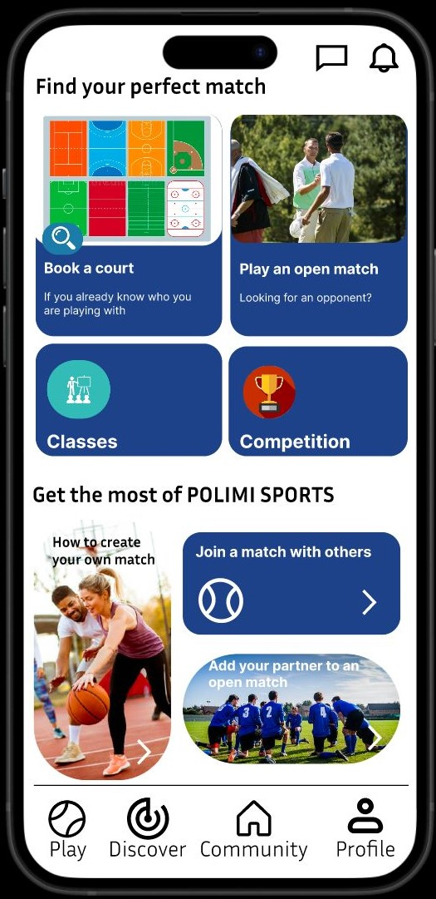
Main Screen

Slide 7
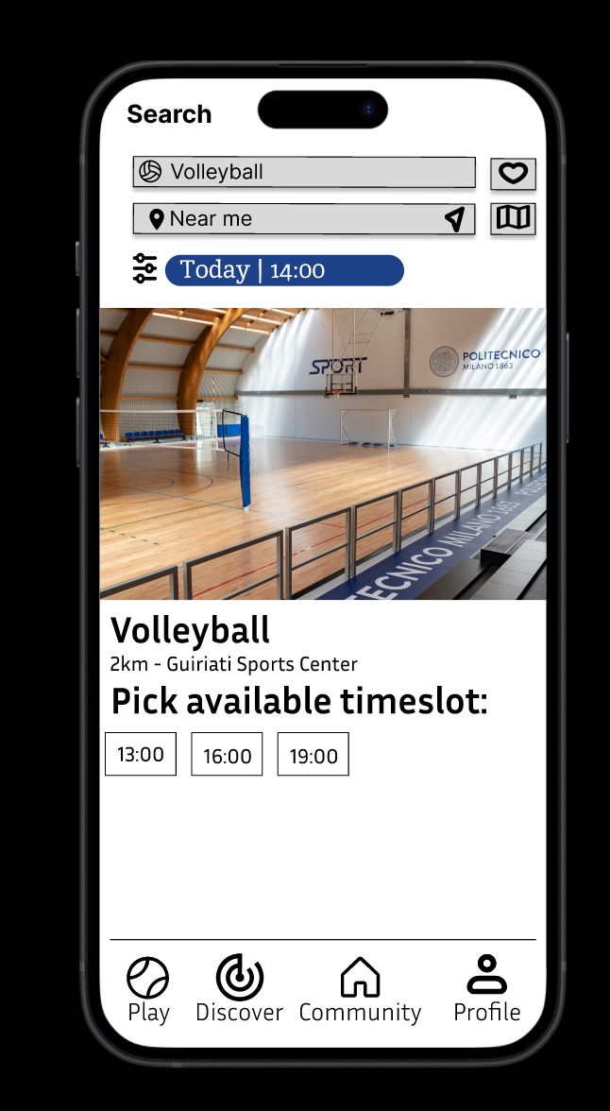
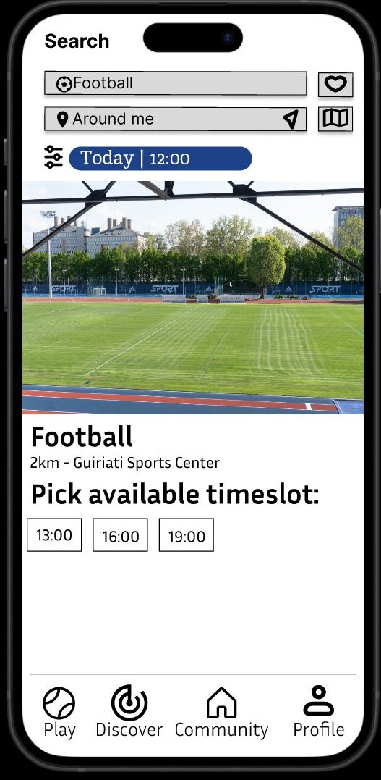
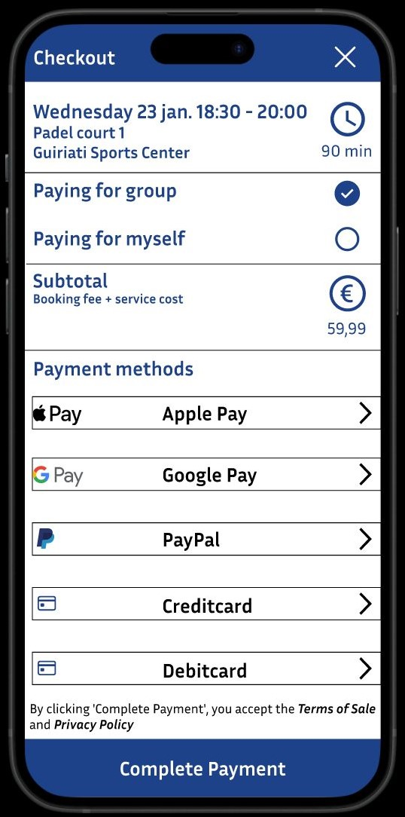
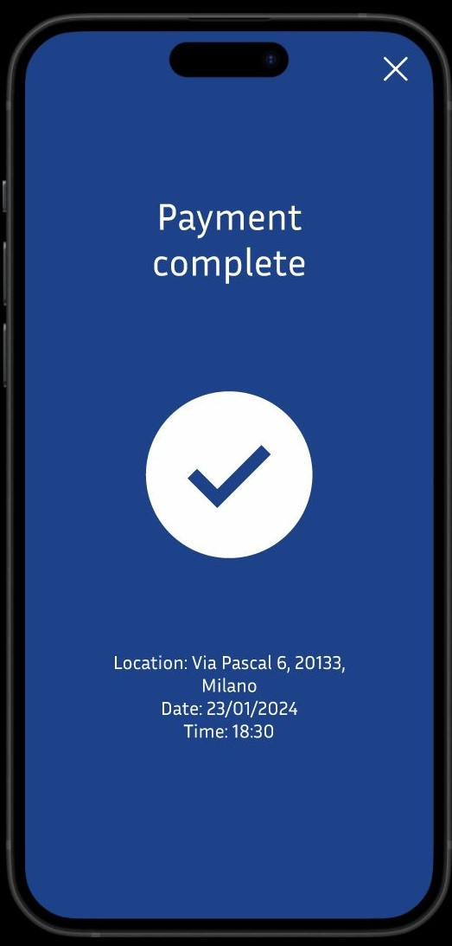
App Layout

Slide 8
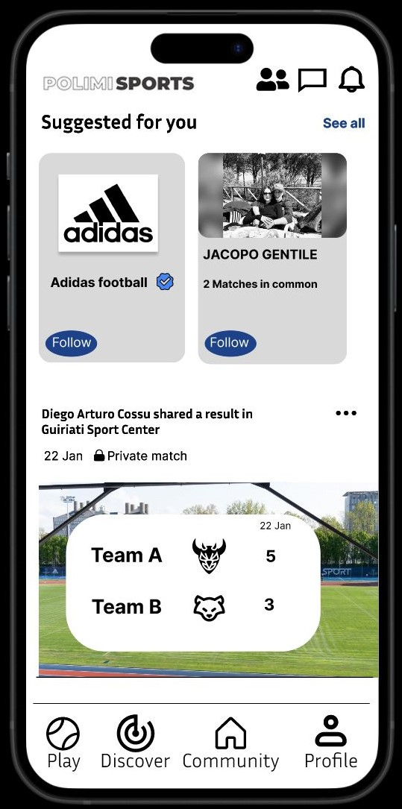
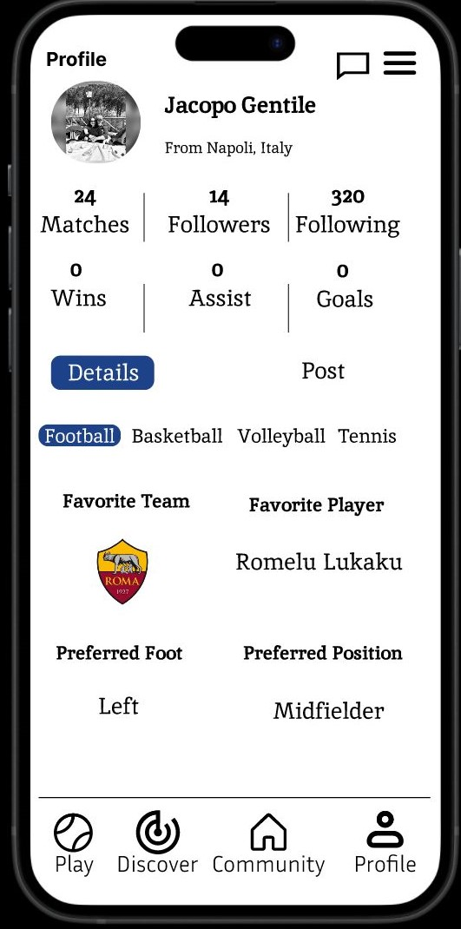
App Layout

Slide 9

Thank You! Grazie ☺

